Slide 1
Notes About Gradient cal

Slide 2
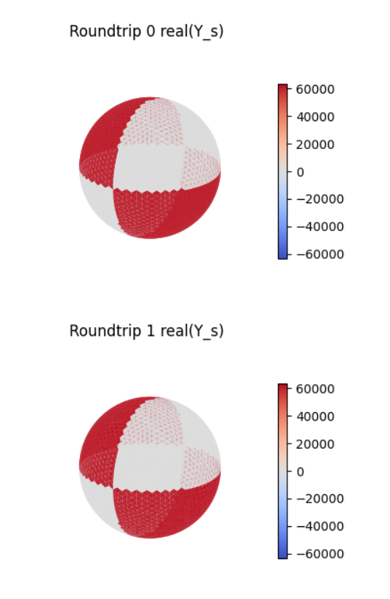
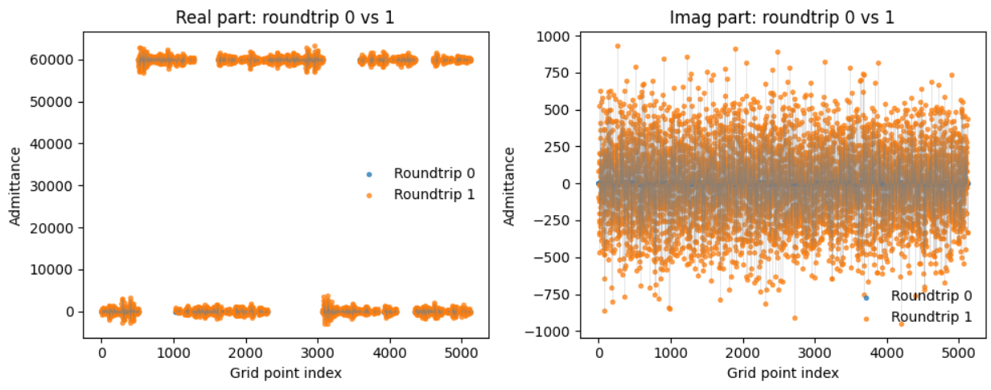

Slide 3
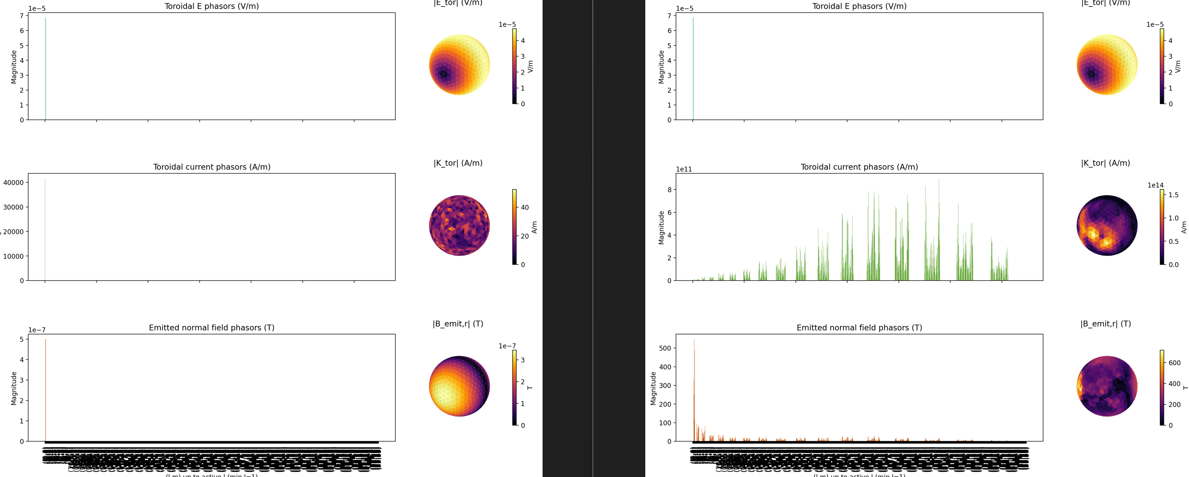
Issue with nonlinear solver, sd=3
For 3 subdiv. , current phasors does not match, nonlinear is DC only

Slide 4
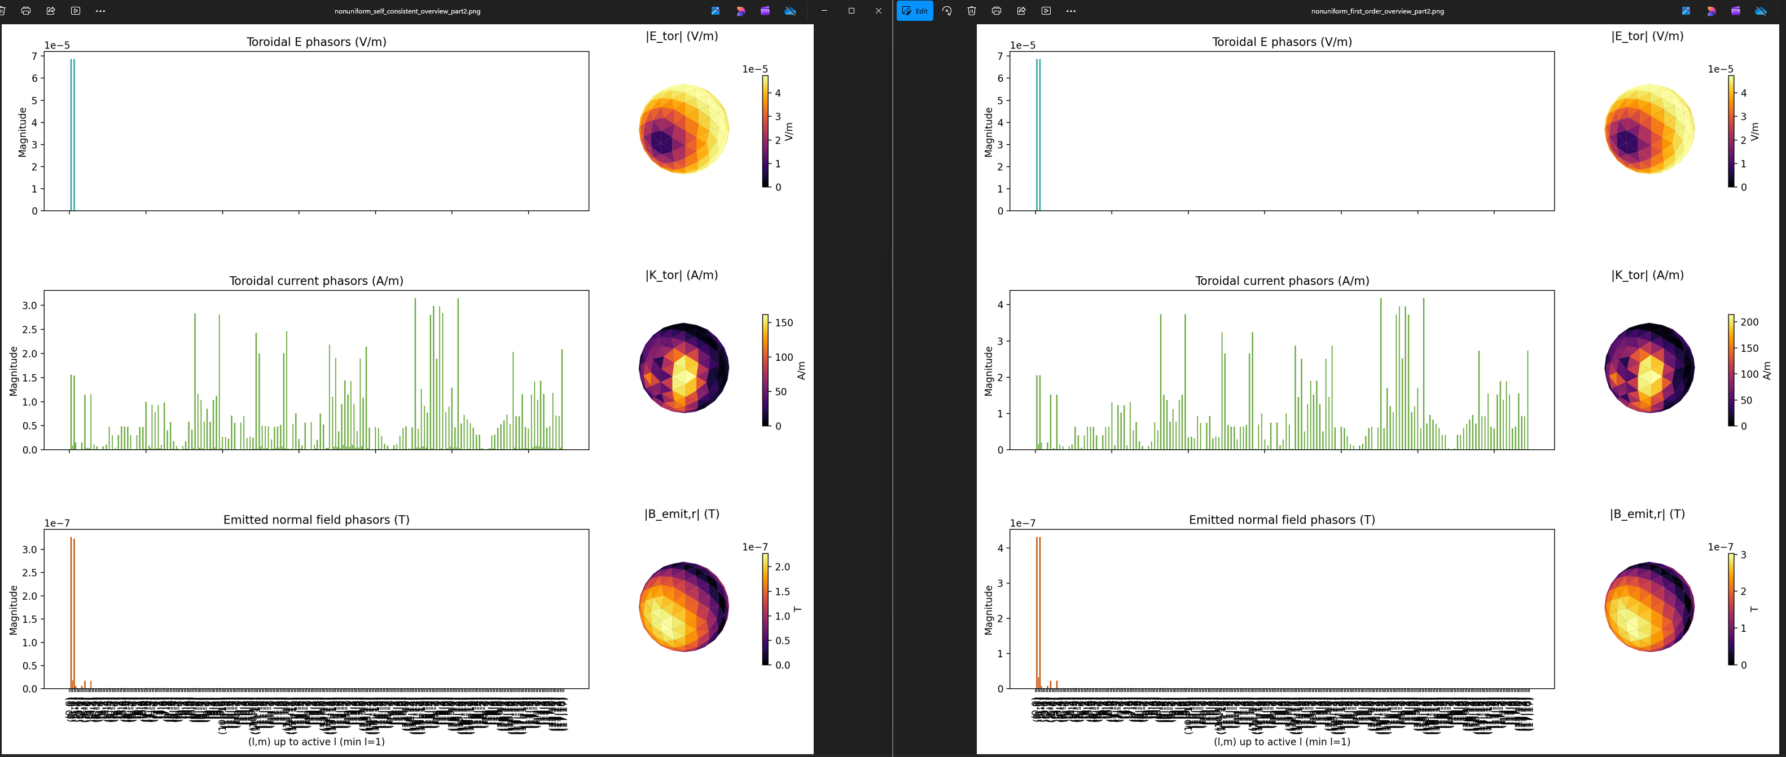
Non linear solver sd=2
Nonlinear closely matches linear for sd=2

Slide 5
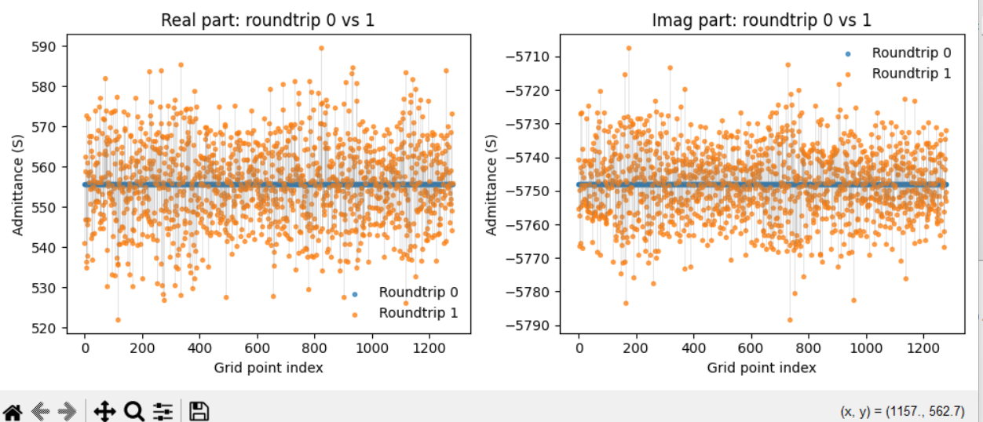
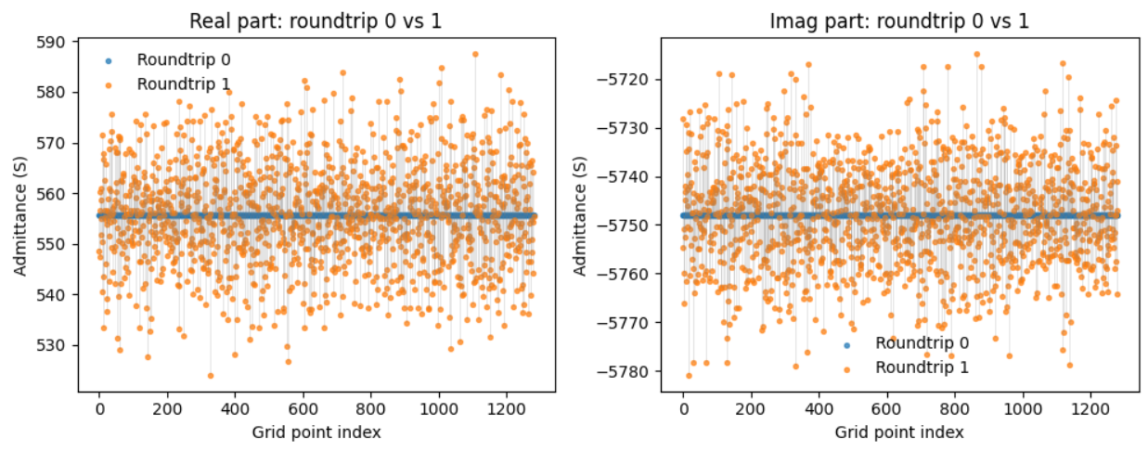
0.00001 % contrast -- unstable
Building sparse mixing matrix...
Solving first-order currents (no feedback)...
b_ext_flat: max|v|=5.000e-07, has_nan=False, has_inf=False
k_flat (first_order): max|v|=1.661e+03, has_nan=False, has_inf=False
K_tor (first_order): total power=1.161e+08, top l fractions: l=26:22.07%, l=28:20.31%, l=30:17.49%, l=24:12.37%, l=32:11.88%, l=22:5.43%
Error: First-order response energy exceeds source energy: resp=3.003e-12 > src=5.000e-13.
Step 1b complete. Displayed round-trip scatter plots.
Assembling Gaunt tensor from data\gaunt_cache_wigxjpf (lmax_limit=35)...
Gaunt tensor nnz=13813899, complete_L=35
Building sparse mixing matrix...
Solving first-order currents (no feedback)...
b_ext_flat: max|v|=5.000e-07, has_nan=False, has_inf=False
k_flat (first_order): max|v|=1.661e+03, has_nan=False, has_inf=False
K_tor (first_order): total power=1.161e+08, top l fractions: l=26:22.07%, l=28:20.31%, l=30:17.49%, l=24:12.37%, l=32:11.88%, l=22:5.43%
Error: First-order response energy exceeds source energy: resp=3.003e-12 > src=5.000e-13.
Cleared outputs in figures and artifacts\workflow.
Step 1 complete (subdivisions=3, faces=1280). Saved grid+admittance to artifacts\workflow\grid_admittance.pt
Step 1b complete. Displayed round-trip scatter plots.
Step 2 complete. Saved ambient + B_radial to artifacts\workflow\ambient.pt
Assembling Gaunt tensor from data\gaunt_cache_wigxjpf (lmax_limit=35)...
Gaunt tensor nnz=13813899, complete_L=35
Building sparse mixing matrix...
Solving first-order currents (no feedback)...
b_ext_flat: max|v|=5.000e-07, has_nan=False, has_inf=False
k_flat (first_order): max|v|=3.960e-01, has_nan=False, has_inf=False
K_tor (first_order): total power=3.223e-01, top l fractions: l=1:97.34%, l=26:0.58%, l=28:0.54%, l=30:0.47%, l=24:0.33%, l=32:0.32%
Step 3 complete. Saved solution to artifacts\workflow\solution_first_order.pt

Slide 6
Stablity
5% level
For checker sub <5 checker mean <= 500 S in full solution
For subdiv =5 checker mean <= 100 S for stability in full solution
Self consistent solution is producing same level of field as radial field – like perfect conductor

Slide 7
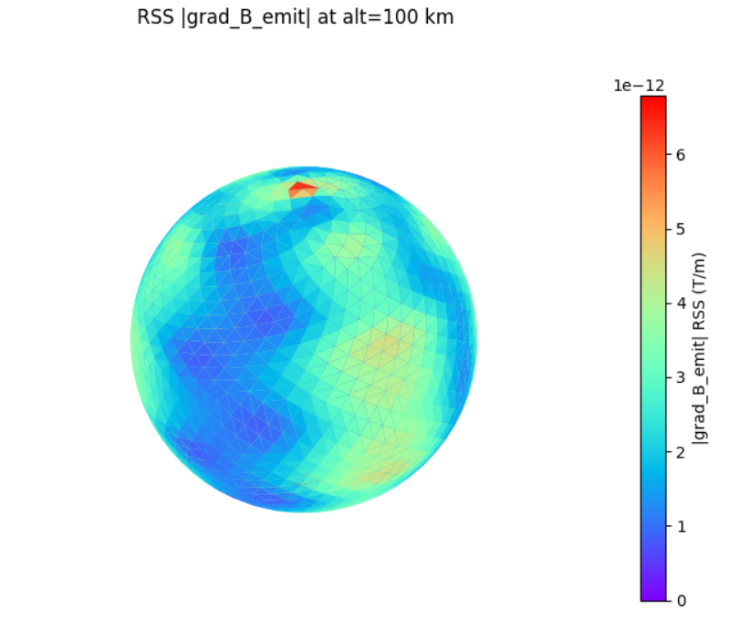
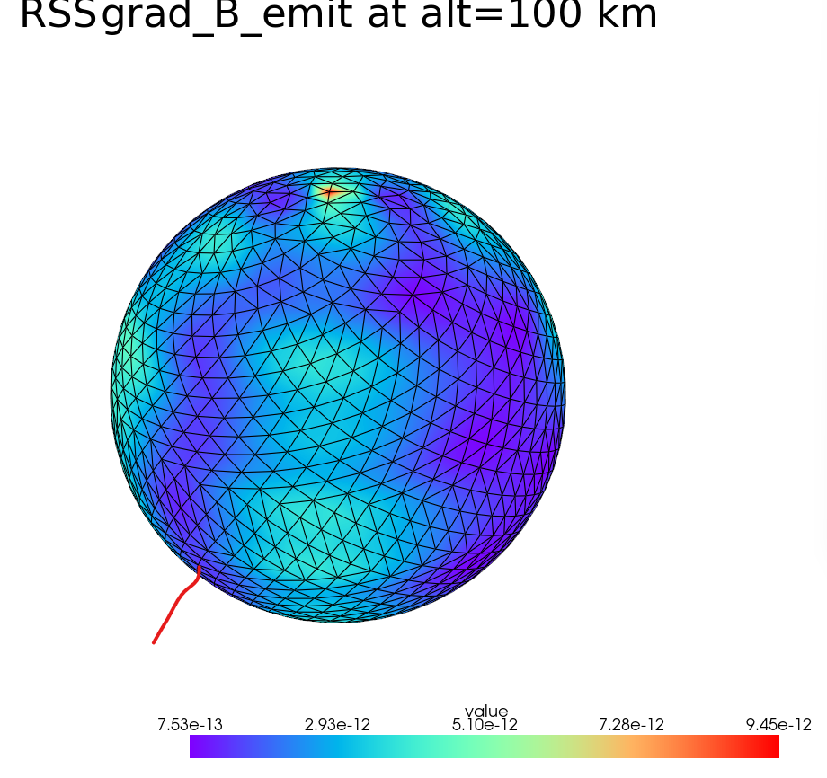
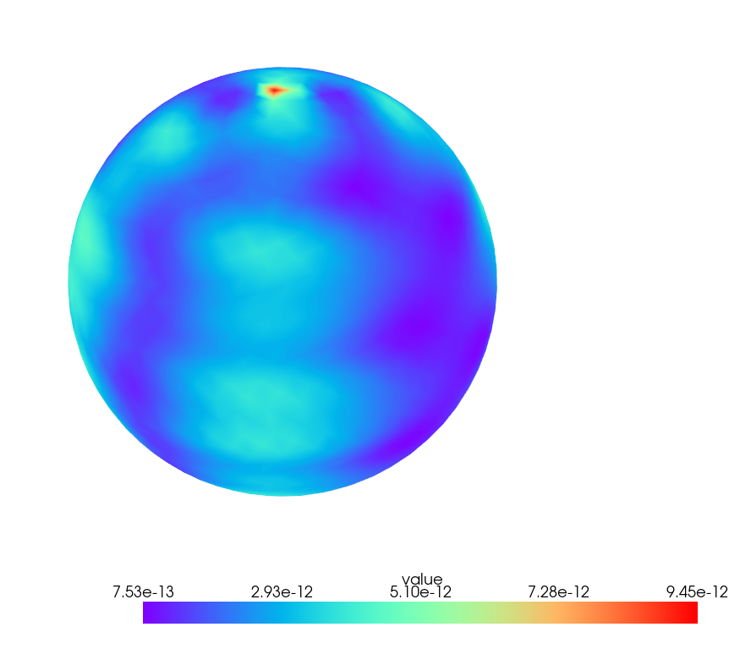
5% conductivity, no inductance Matplot lib vs pylanc
Matplot lib
Py vista has interpolation but is less clear choose
matplotlib as the default
Few pT/m
Pyvista

Slide 8
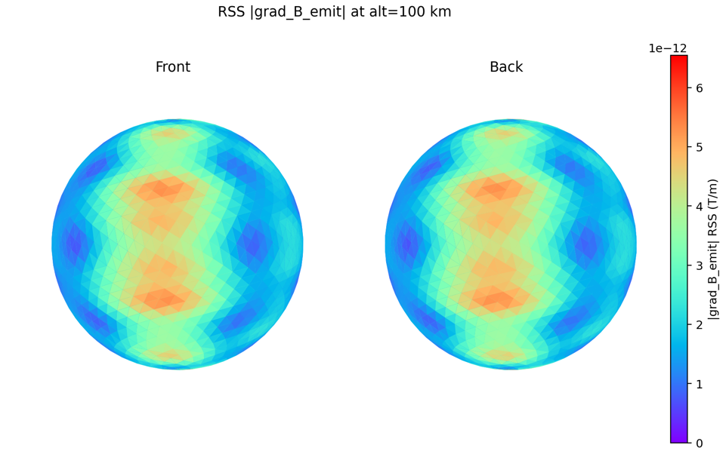
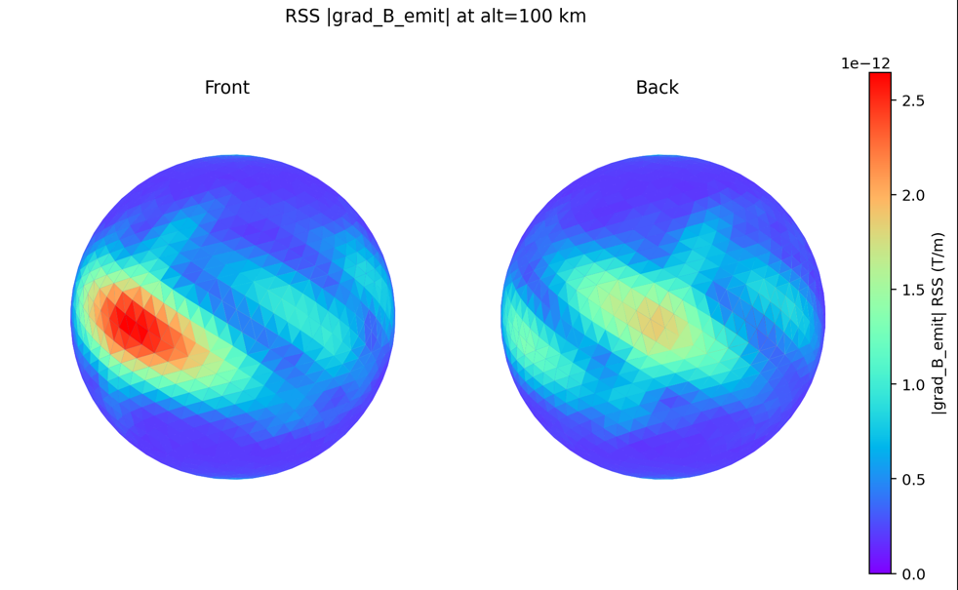
Effect of Inductance on Gradient
No Inductance
5% surface variation
Inductance scale gradient by factor for
Why is inductance solution not 180 degree rotationally symmetry
the ambient driver i a +X‑directed dipole pattern
Would be interesting to add mag field lines at the peak of the cycle
With Inductance

Slide 9
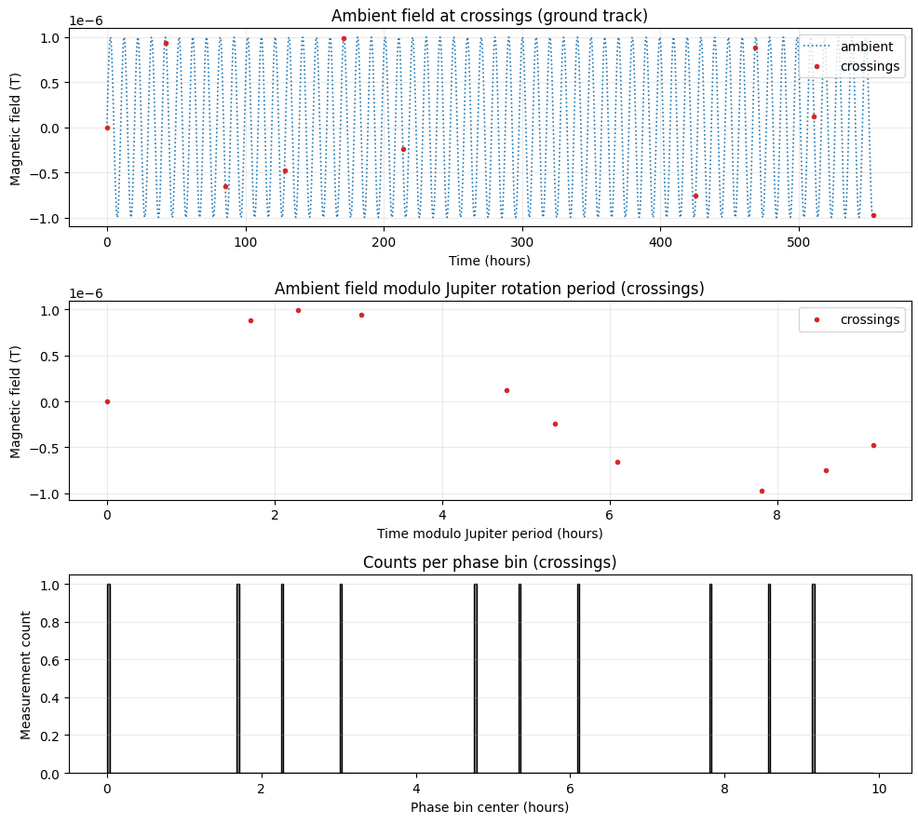
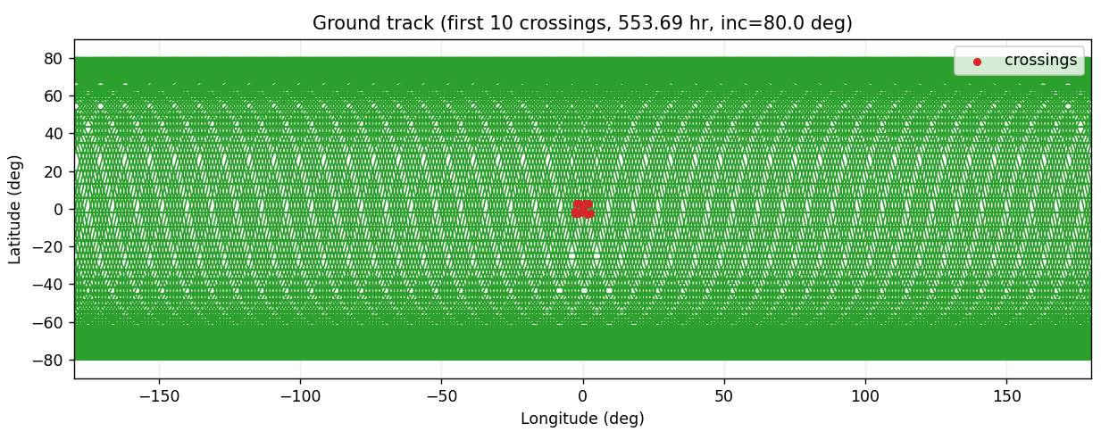
Orbital Considerations
Average crossing interval: 61.521 hours (221476.7 s)
Europa polar circular orbit (100 km altitude)
omega = 8.368765e-04 rad/s
speed = 1389.215 m/s
period = 2.086 hours
node mean spacing = 159.042 km
node transit time = 114.483 s
Europa rotation omega = 2.047827e-05 rad/s
Europa rotation during orbit = 1.537488e-01 rad
node angle (equator) = 9.580832e-02 rad
node drift per orbit = 1.605 nodes
field period (Jupiter rotation) = 9.925 hours
phase coverage gap = 110.480 s
phase coverage time = 821.698 hours
phase coverage orbits = 394
phase bin mean = 0.032
phase bin std = 0.176

Slide 10
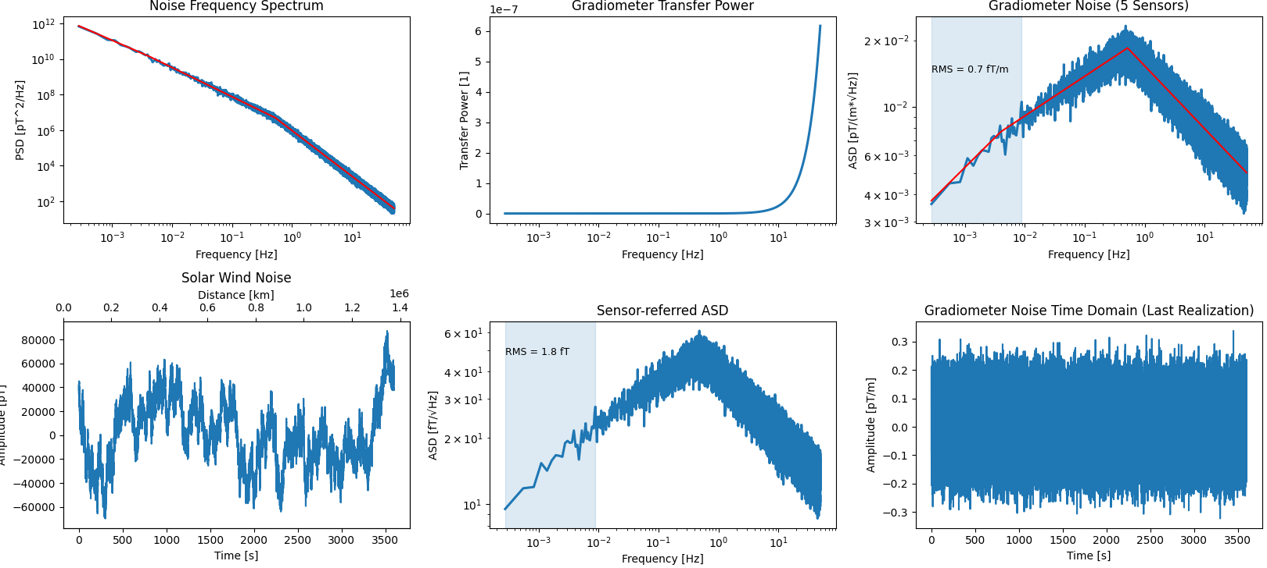
Solar Wind Noise RMS of 10 m boom
For 10m, 100km gradiometers Correlations time is well under a second
Node transit time: 114.483 s
RMS frequency range: 0 to 8.734921e-03 Hz
RMS noise: 0.7 fT/m
ASD = Amplitude Spectral Density
Would need 30 fT noise to match solar wind reduction
However , Gradients from 5% changes in conductivity are at the are at pT/m level > 1000 times the solar wind noise
So we could get 100s of fT and still measure

Slide 11
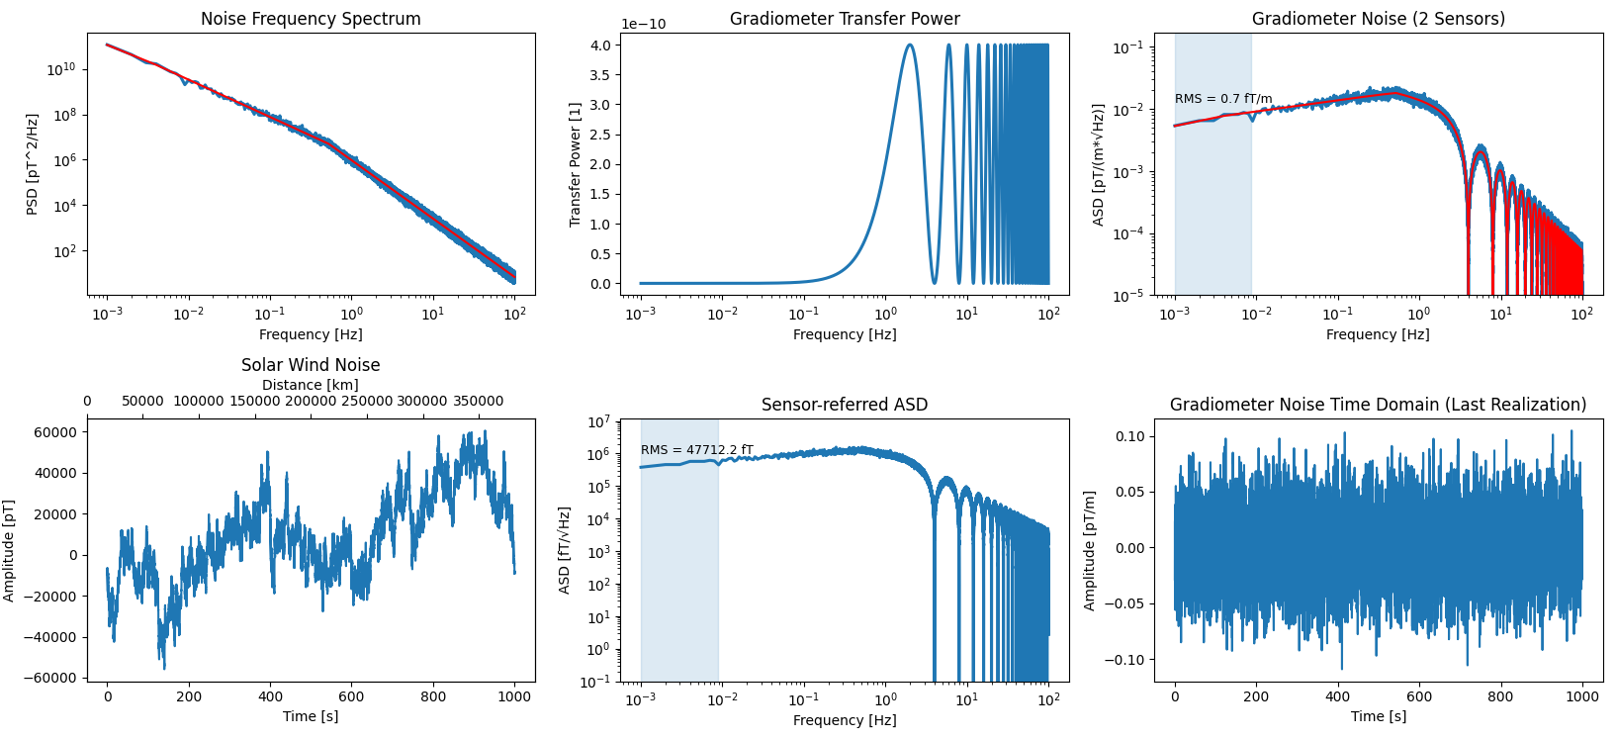
Solar Wind Noise RMS of 100 km Gradometer
Node transit time: 114.483 s
RMS frequency range: 0 to 8.734921e-03 Hz
RMS noise: 0.7 fT/m

